Slide 1

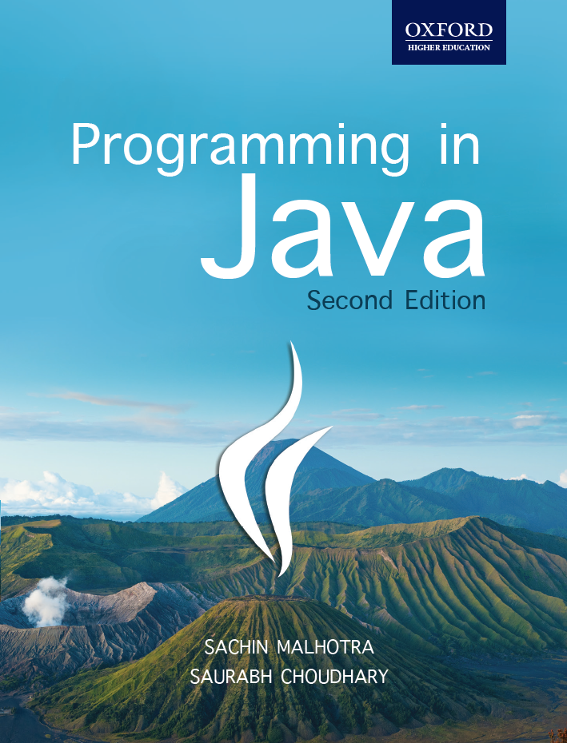
Programming in Java, 2e
Sachin Malhotra
Saurabh Choudhary

Slide 2
Chapter 9
Input Output, Serialization & Cloning

Slide 3
Objective
understand the basics of file handling
understand how Input/Output operation is done in Java
understand how Input is taken from the user
understand the concept behind serialization and how it is done
Understand the various types of cloning and how are they performed

Slide 4
Introduction
As of Java 1.4, there are two predefined packages named io (input/output) and nio (new I/O)
The java.io package deals with operations like reading/writing to console, reading/writing to files, etc.
The java nio package contains classes that support the classes in the java.io package and perform advanced operations like buffering, character encoding and decoding, pattern matching, locking a file, etc.

Slide 5
Streams
The java.io package provides separate classes for reading and writing data (byte and character data), based on Streams.
Stream is a continuous flow of data.
In Java, streams for both types of data have been defined: byte stream classes and character stream classes.
  Byte stream classes deal with reading and writing of bytes to files, socket, etc.
  Character Stream classes deal with reading and writing of characters to files, socket, etc.

Slide 6
Streams (contd.)
The java.io package contains two top level byte stream abstract classes:
  java.io.InputStream (for reading bytes) and
  java.io.OutputStream (for writing bytes).
It also contains two other top level character stream abstract classes:
  java.io.Reader (for reading characters) and
  java.io.Writer (for writing characters).
The subclasses of these classes are actually used for reading and writing data.

Slide 7
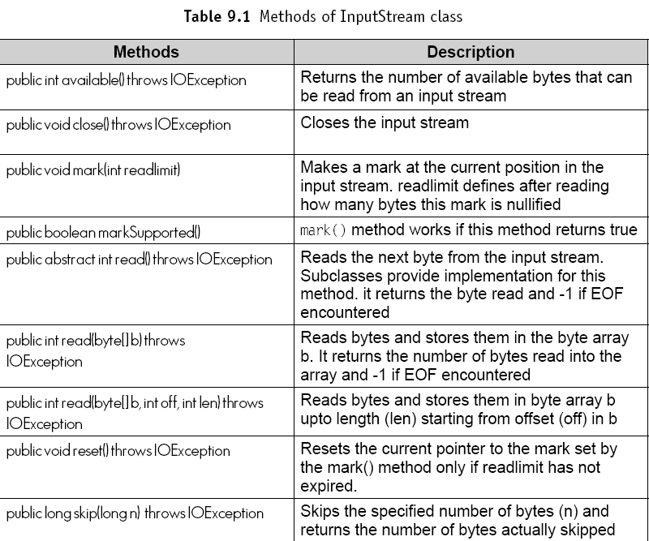
java.io.InputStream

Slide 8
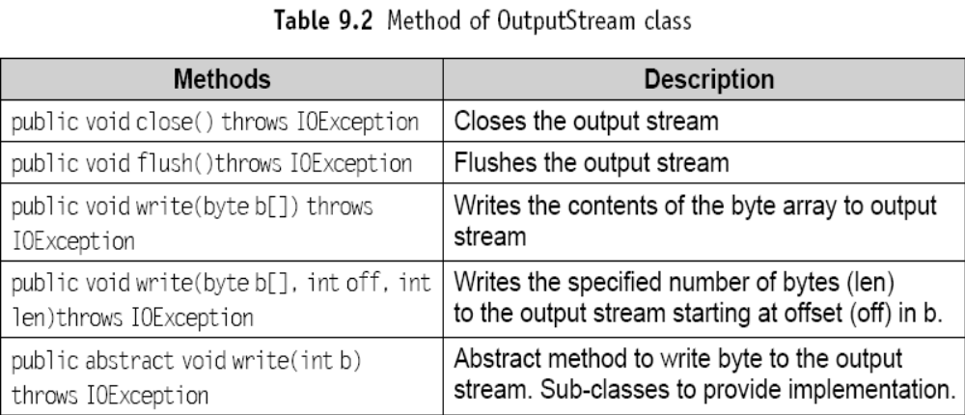
java.io.OutputStream

Slide 9
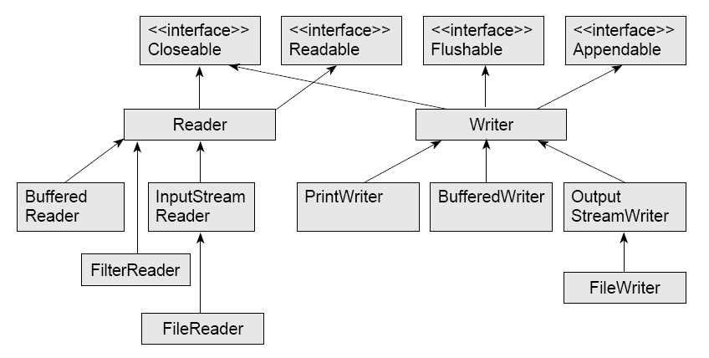
Classes under Reader and Writer

Slide 10
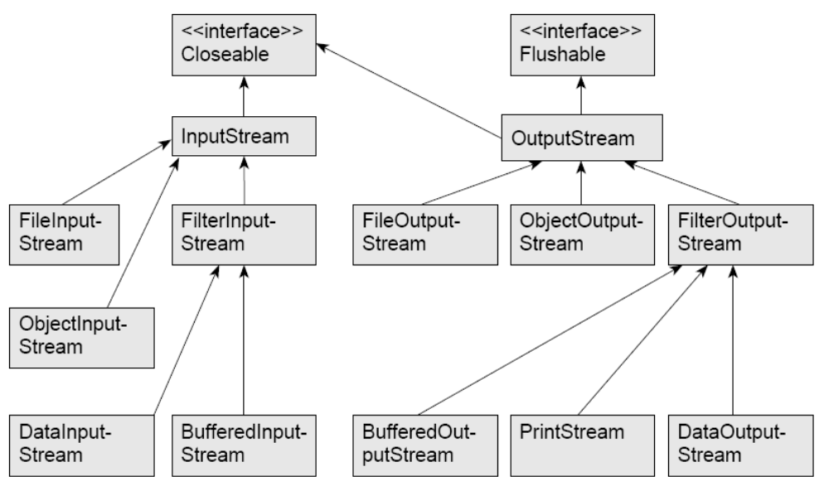
Classes under InputStream and OutputStream

Slide 11
java.io.File class
The java.io.File class is worth mentioning, as it neither belongs to the Byte stream nor the character stream used for reading or writing a file.
This class is used to know the properties of a file like
  path of the file,
  whether the file exists or not,
  whether the file is a file or a directory,
  length of the file, etc.

Slide 12
java.io.File Example
File f=new File(args[0]);
System.out.println(“File exists: “+f.exists());
System.out.println(“File can be read:“+f.canRead());
System.out.println(“File can be written: “+f.canWrite());
System.out.println(“File can be executed:“+f.canExecute());
System.out.println(“File name: “+f.getName());
System.out.println(“parent of File:“+f.getParent());
System.out.println(“path of the File:“+f.getPath());
System.out.println(“Hidden File: “+f.isHidden());
System.out.println(“length of the file: “+f.length());
System.out.println(“last modified time: “+f.lastModified());
System.out.println(“it is a File: “+f.isFile());

Slide 13
Reading/Writing Data using Byte Stream classes
import java.io.*;
class ReadWriteDemo{
public static void main(String args[]) throws IOException{
if(args.length!=2)
{
System.out.println(“Usage: java ReadWriteDemo Sample.txt Demo.txt”);
System.exit(0); // terminate the program
}
File f=new File(args[0]);
byte[] b={};

Slide 14
Example (contd.)
//Reading a file
if(f.exists()){
FileInputStream f1=new FileInputStream(f);
int num=f1.available();
b=new byte[num];
int n=f1.read(b);
String s=new String(b);
System.out.println(“Contents of “+args[0]+ “: “+ s);
f1.close();
f=null; }
else {
System.out.println(“File does not exist”);
System.exit(0);
}

Slide 15
Reading/Writing Data using Byte Stream classes
//writing to file
f=new File(args[1]);
if(!f.exists())
System.out.println(args[1]+” is a New File”);
else
System.out.println(args[1]+” File exists, will be overwritten”);
System.out.println(“Opening File: “+ args[1]);
FileOutputStream fs=new FileOutputStream(args[1]);
System.out.println(“File Opened, now writing contents”);
fs.write(b);
fs.flush();
System.out.println(“contents written”);
System.out.println(“Closing File”);
fs.close(); }}

Slide 16
The output
C:\javabook\programs\CHAP09~1>java ReadWriteDemo Sample.txt Demo.txt
  Contents of Sample.txt: This is my sample file
  Demo.txt is a New File
  Opening File: Demo.txt
  File Opened, now writing contents
  contents written
  Closing File
C:\javabook\programs\CHAP09~1>java ReadWriteDemo Sample.txt Demo.txt
  Contents of Sample.txt: This is my sample file
  Demo.txt File exists, will be overwritten
  Opening File: Demo.txt
  File Opened, now writing contents
  contents written
  Closing File

Slide 17
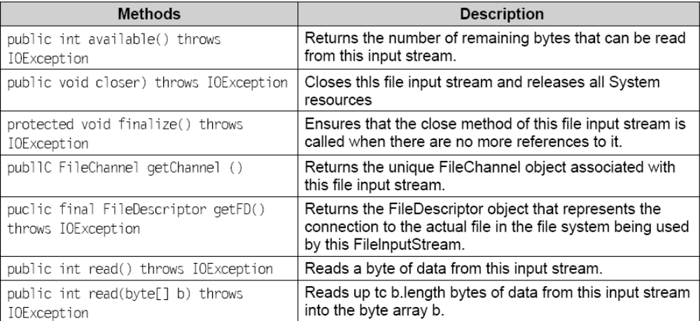
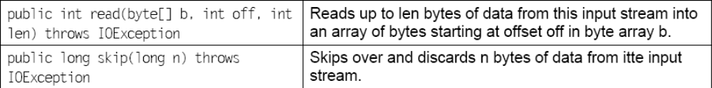
Methods of FileInputStream

Slide 18
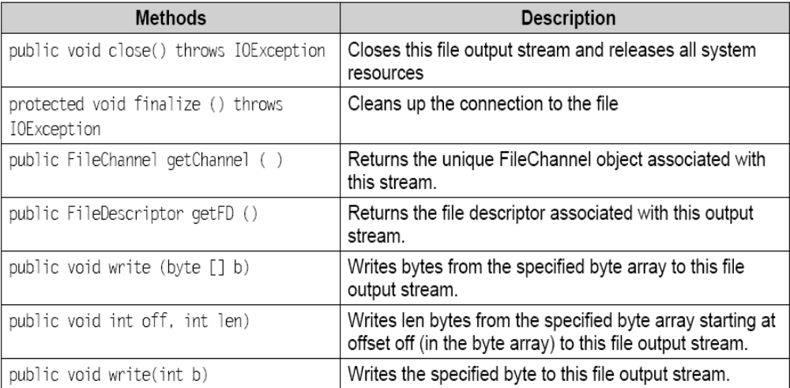
Methods of FileOutputStream

Slide 19
User Input
Three ways of taking user input:
  BufferedReader class (JDK 1.4 and prior)
  Scanner class (introduced in JDK 5)
  Console class (introduced in JDK 6)

Slide 20
BufferedReader
Prior to JDK 5, BufferedReader was used to read inputs from the user.
The following statements shows how to get the input from the user using BufferedReader class.
try
{. . .
BufferedReader br=new BufferedReader(new InputStreamReader (System.in));
String x=br.readLine();
. . . }
catch(IOException e)
{. . .}

Slide 21
java.util.Scanner class
Prior to JDK 6, JDK 5 introduced the Scanner class (java.util package) which can be used for getting input from user (both lines of text as well as primitives)
Can also be used for breaking the input String into tokens separated by a delimiter which is by default a white space.

Slide 22
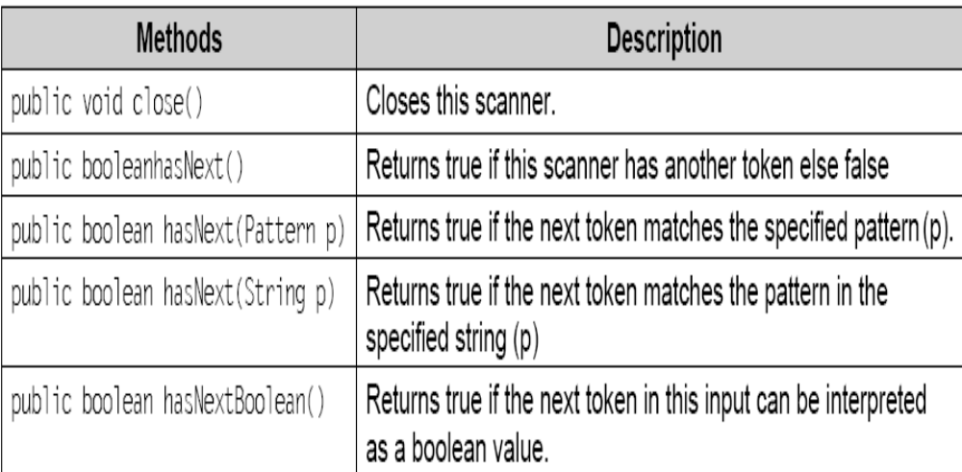
Methods of Scanner class

Slide 23
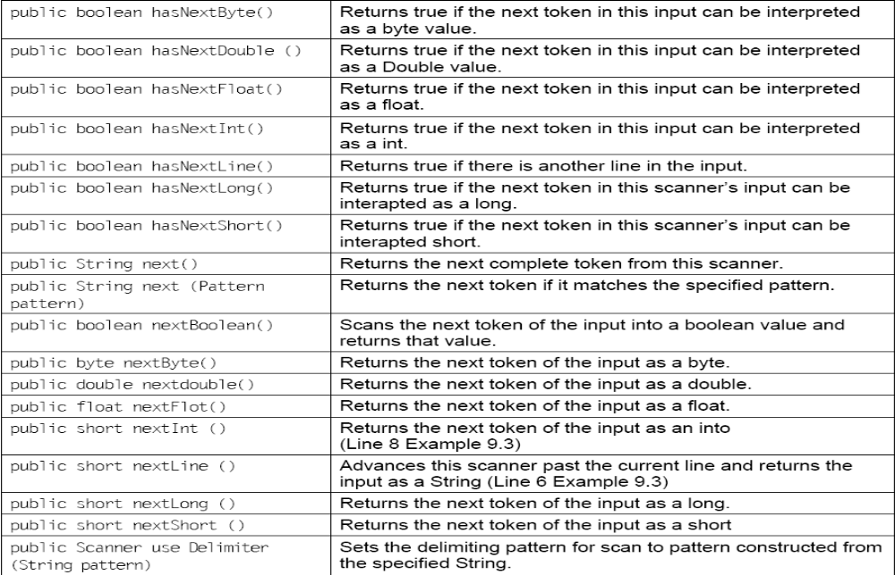
Methods of Scanner class

Slide 24
Example
import java.util.*;
class ScannerDemo {
public static void main(String args[]) {
Scanner sc=new Scanner(System.in);
System.out.print(“Enter your name: “);
String name=sc.nextLine();
System.out.print(“Enter your age: “);
int age=sc.nextInt();
System.out.println(“you entered “+name+” as your name”);
System.out.println(“you entered “+age+” as your age”); }}

Slide 25
The Output
C:\javabook\programs\chap 09>java ScannerDemo
Enter your name: Ram
Enter your age: 31
you entered Ram as your name
you entered 31 as your age

Slide 26
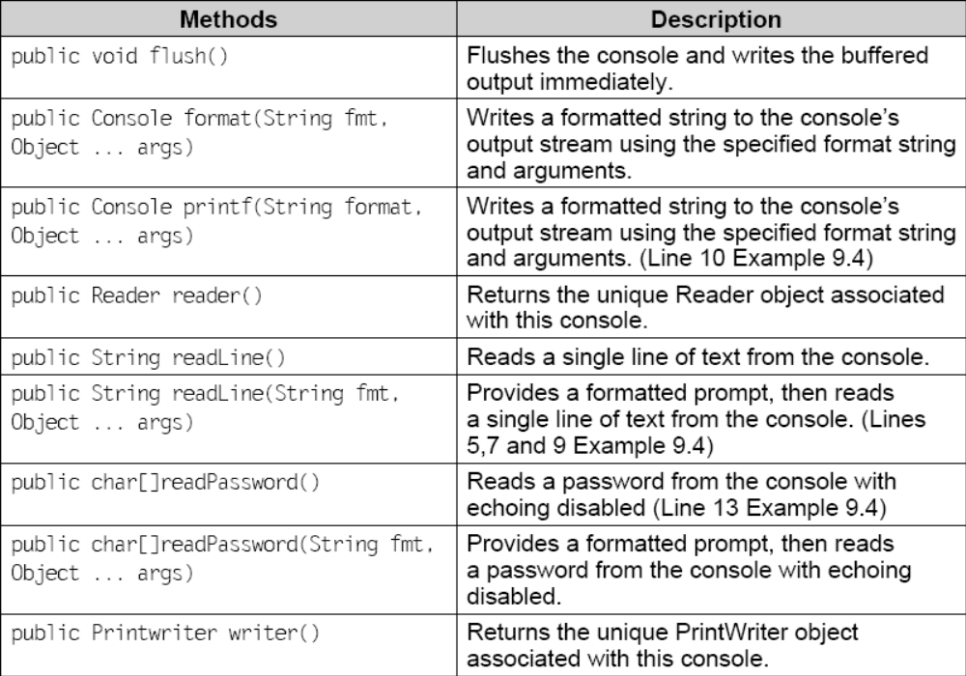
Console class

Slide 27
Example
Console c=System.console();
String user=c.readLine(“Enter your username: ”);
String pno=c.readLine(“\nEnter your Phone No.: ”);
String age=c.readLine(“\nEnter your AGE: ”);
// another way of Writing to the Console
PrintWriter out=c.getWriter();
out.println(“\nEnter your password”);
char[] pass=c.readPassword();

Slide 28
Reading/Writing using Character stream
import java.io.*;
class ReadWriteDemo1{
public static void main(String args[]) throws IOException{
File f=new File(args[0]);
int n;
//Reading a File
if(f.exist())
{
FileReader fr=new FileReader(f);
System.out.println(“Reading “+args[0]);
while((n=fr.read())!=-1)
System.out.print((char)n);
} else
System.out.println(args[0]+” does not exists”);

Slide 29
Reading/Writing using Character stream
//writing to a file
System.out.println(“\nWriting “+args[1]);
FileWriter fw= new FileWriter(args[1]);
String s=”This is my sample File”;
fw.write(s);
fw.close();
}
}

Slide 30
The Output
C:\javabook\programs\CHAP09~1>java ReadWriteDemo1 Sample1.txt Demo1.txt
Reading Sample1.txt
This is my sample File
Writing Demo1.txt

Slide 31
Reading/Writing using Buffered byte stream classes
BufferedInputStream class is used for
  buffering the input and
  it supports operation to re-read the files.
BufferedOutputStream class is used to
  buffer the output and
  enhance the performance.

Slide 32
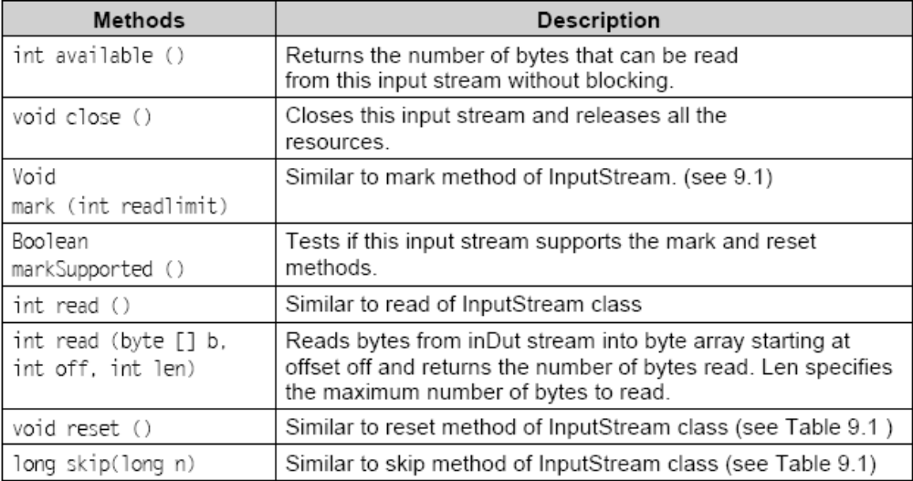
Methods of BufferedInputStream

Slide 33
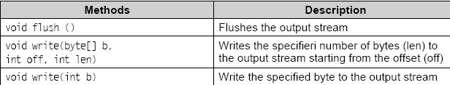
Methods of BufferedInputStream

Slide 34
Example
import java.io.*;
class BufferedInOutStreamDemo {
public static void main(String args[]) throws IOException {
FileInputStream fis=new FileInputStream(args[0]);
BufferedInputStream bis=new BufferedInputStream(fis);
int n=fis.available();
bis.mark(n);
System.out.println(“Marked the stream”);
byte b[]=new byte[n];
byte b1[]=new byte[n];
bis.read(b);
System.out.println(“Contents of “+args[0]+”: “+new String(b));
System.out.println(“Resetting the stream”);

Slide 35
Example (contd.)
bis.reset();
System.out.println(“Reading the stream again ”);
bis.read(b1);
System.out.println(new String(b1));
bis.close();
fis.close();
/*Line 20*/ System.out.println(“Writing contents to : “+args[1]);
FileOutputStream fos=new FileOutputStream(args[1]);
BufferedOutputStream out=new BufferedOutputStream(fos);
/*Line 23*/ out.write(b);
/*Line 24*/ System.out.println(“Contents written”);
/*Line 25*/ out.close(); fos.close();
}}

Slide 36
The Output
C:\javabook\programs\chap09>java BufferedInOutStreamDemo sample.txt Demo.txt
Marked the stream
Contents of sample.txt: This is my sample file
Resetting the stream
Reading the stream again
This is my sample file
Writing contents to : Demo.txt
Contents written

Slide 37
Reading/Writing using Buffered character stream classes
BufferedReader class is used for
  buffering the input and
  it supports operation to re-read the files
  just like BufferedInputStream
BufferedWriter class is used to
  buffer the output and
  enhance the performance
  just like BufferedOutputStream
Let us take an example to show these two classes:

Slide 38
Example
import java.io.*;
class BufferedReadWriteDemo {
public static void main(String args[]) throws IOException {
int n;
FileReader fr=new FileReader(args[0]);
System.out.println(“File opened: “+args[0]);
BufferedReader br=new BufferedReader(fr);
PrintWriter out=new PrintWriter(System.out,true);
String str;
FileWriter fw= new FileWriter(args[1]);
BufferedWriter bw=new BufferedWriter(fw);

Slide 39
Example (contd.)
while((str=br.readLine())!=null)
{
out.println(str);
bw.write(str+”\n”);
}
System.out.println(“Contents copied to: “+args[1]);
br.close();
br.close();
fr.close();
fw.close(); }}

Slide 40
The Output
C:\javabook\programs\CHAP09~1>java BufferedReadWriteDemo Sample1.txt Demo2.txt
File opened: Sample1.txt
This is my sample file
Contents copied to: Demo2.txt

Slide 41
Randomly Accessing a File
RandomAccessFile gives an opportunity to read or write files from a specific location.
This class has a method named seek (long pos) that sets the file pointer at the specified position (pos).
Now any read/write operation on the file will start from this marked position.
A complete list of methods of RandomAccessFile class is shown in table 9.9.
In the following example, we have used seek( ) method to set the file pointer to end of file (EOF) and then write the contents to the file. In other words, we are appending the file.

Slide 42
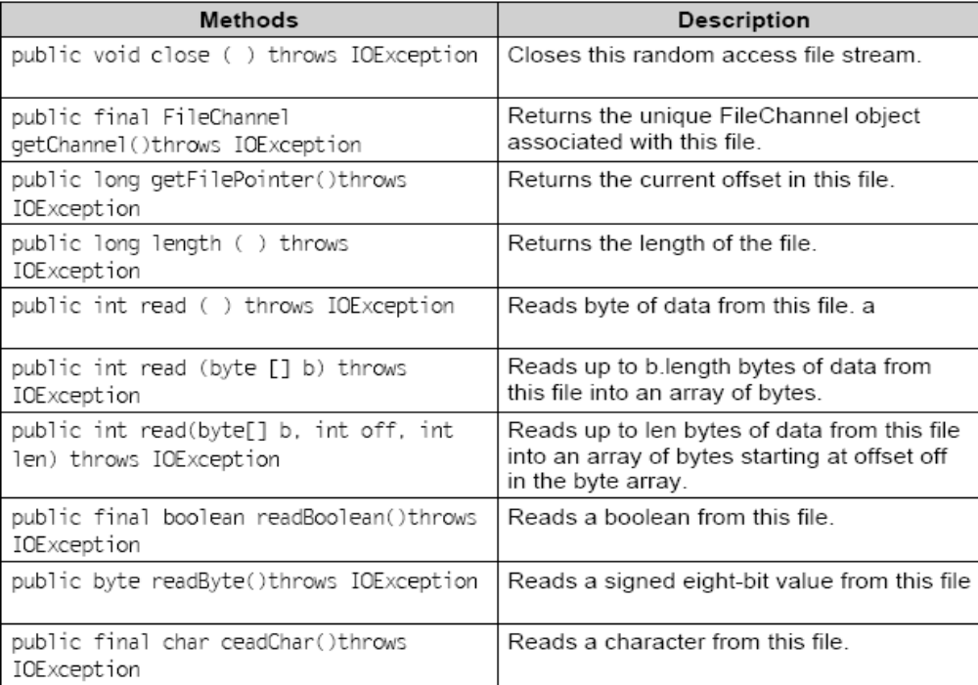
Methods

Slide 43
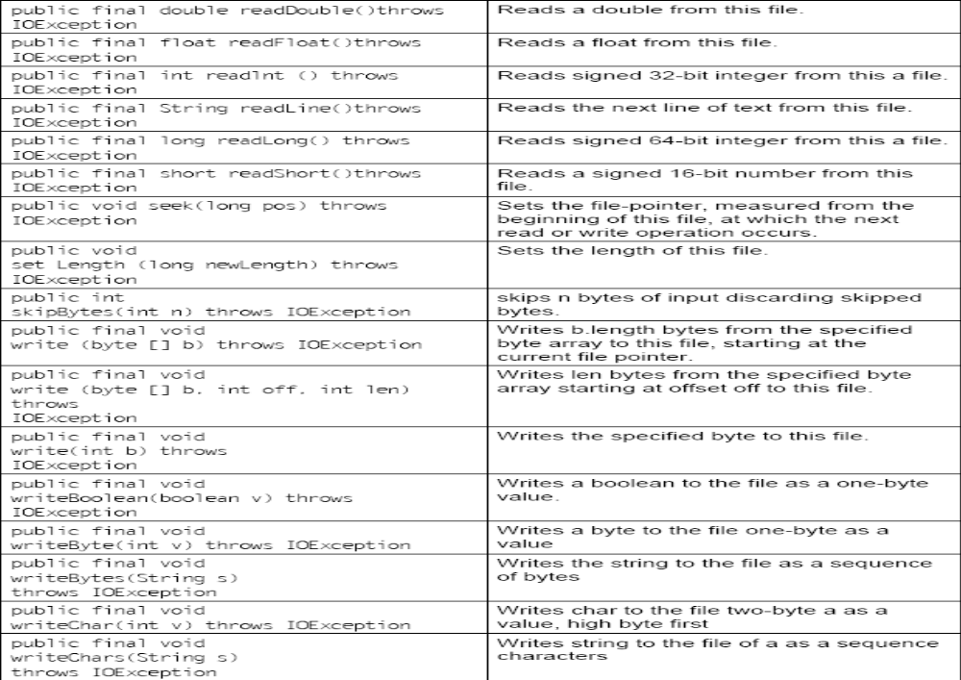
Methods

Slide 44
Example
import java.io.*;
class RandomAccessFileDemo {
public static void main(String args[]) throws IOException{
System.out.println(“Opening the file in read write mode”);
RandomAccessFile raf=new RandomAccessFile (“Sample.txt”,”rw”);
raf.seek(raf.length());
String str=”\nContents appended using RandomAccessFile”;
System.out.println(“Appending contents to file”);
raf.write(str.getBytes());
System.out.println(“Contents appended”);
System.out.println(“Reading the contents of the file....”);
raf.seek(0);
while((str=raf.readLine())!=null)
System.out.println(str);
raf.close(); }}

Slide 45
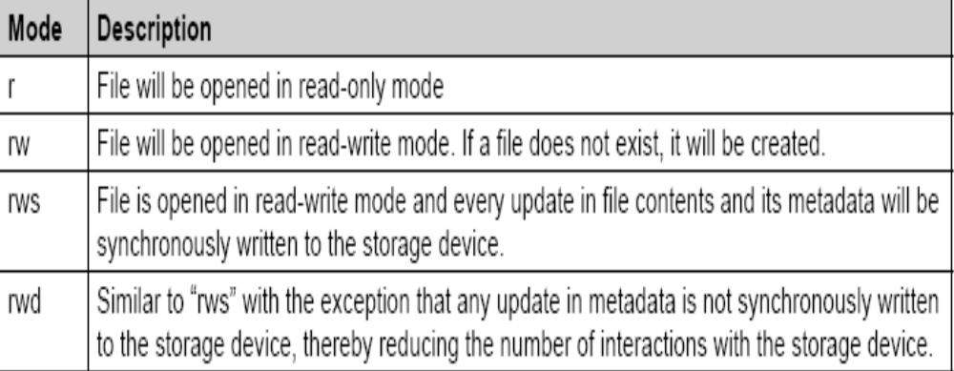
Modes in RandomAccessFile

Slide 46
The Output
C:\javabook\programs\CHAP09~1>java RandomAccessFileDemo
Opening the file in read write mode
Appending contents to file
Contents appended
Reading the contents of the file....
This is my sample File
Contents appended using RandomAccessFile

Slide 47
Reading/Writing using nio
The java.nio package is used to perform advanced I/O operations like
  memory mapping of files,
  file locking,
  buffer classes have been provided for all primitive types,
  channels representing connections to files.
Memory mapping is a concept used in virtual memory.
The entire file or region of a file (for large files) is mapped byte to byte between the file and the virtual memory.
The mapped file is treated as it is actually present in the primary memory, thereby increasing the performance of I/O.
Let us take an example to understand the concept better.

Slide 48
New i/o Example
import java.io.*;
import java.nio.*;
import java.nio.channels.*;
public class ReadWriteUsingNIO {
public static void main(String args[]) {
try { //Use a mapped file to read a text file
FileInputStream fis = newFileInputStream (“Sample.txt”);
FileChannel fc = fis.getChannel();
long fs = fc.size();
MappedByteBuffer mBuf = fc.map (FileChannel.MapMode.READ_ONLY, 0, fs);
for (int i = 0; i < fs; i++)
System.out.print((char) mBuf.get());
fc.close();
fis.close();

Slide 49
New i/o Example (contd.)
// write to a file using nio
String str=”welcome, writing to a file using nio package”;
FileOutputStream fos = new FileOutputStream(“samplenio.txt”);
FileChannel fc1 = fos.getChannel();
ByteBuffer buffer = ByteBuffer.allocate(str.length());
byte[] b = str.getBytes();
buffer.put(b);
buffer.flip();
fc1.write(buffer);
fc1.close();
fos.close();
}catch (Exception e) {
System.out.println(e);
}}}

Slide 50
Explanation
Line 10: static method map of FileChannel class is used to get a MappedByteBuffer object. MappedByteBuffer object is a byte buffer whose content defines the memory mapped file. The map method takes three arguments:
  mode: Three modes for mapping are available.
    a)read: read only mapping (FileChannel.MapMode.READ_ONLY)
    b) read-write: (FileChannel.MapMode.READ_WRITE). If the contents of the buffer are manipulated, then they are written to the mapped file.
    c) private: buffer manipulations will not be written to file.
    MapMode is a Static inner class in FileChannel class. READ_ONLY, READ_WRITE, PRIVATE are static fields within the class.
  position – point at which mapping in a file starts. This value cannot be negative.
  size – size of the mapping. This value cannot be negative.

Slide 51
Java 7 nio enhancements
java.nio.file package is added in Java 7
use new classes like Files and interfaces like Path instead of the legacy class like java.io.File
new interface SeekableByteChannel is also added in java.nio.channels package whichis similar to the java. io.RandomAccessFile
java.nio.file.Files class provides a number of static methods to move a file, copy a file, creating a new file, and deleting it.
Path object is used to locate a file on the system.

Slide 52
Paths and Files class
Path file = Paths.get("D:/Second Edition/ programs/ chap9/DemoThis.java");
System.out.println("Name Count: "+file.getNameCount());
System.out.println("File System: "+file.getFileSystem());
System.out.println("File Name: "+file.getFileName());
System.out.println("Parent: " +file.getParent());
System.out.println ("Name starts with a DemoThis.java: "+file.startsWith("Demothis.java"));
System.out.println("Hidden File: " + Files.isHidden(file.getFileName()));
System.out.println("Directory: "+Files.isDirectory(file.getFileName()));

Slide 53
Paths and Files class
System.out.println("Regular File: " + Files.isRegularFile(file.getFileName()));
System.out.println("Executable:"+Files.isExecutable(file.getFileName()));
System.out.println("Readable:"+Files.isReadable(file.getFileName()));
System.out.println("Writable:"+Files.isWritable(file.getFileName()));
System.out.println("Exists: "+Files.exists(file.getFileName()));
System.out.println("Last Modified Time: "+Files.getLastModifiedTime(file.getFileName()));
System.out.println("Size: "+Files.size(file.getFileName()) +" bytes");

Slide 54
Serialization
process of converting an object to bytes so that its state can be made persistent.
The state is made persistent by writing the bytes to a file.
The state of object is defined by its properties (value of the instance variables).
De-serialization is the reverse of serialization. It is the process of converting bytes back to object.
Why an object should be made persistent?
  Normally we create objects, work with them, and when the job is done, they are garbage collected automatically. But suppose, we need the value of the instance variables at a later point of time, then the values won’t be available. So in this case, serialization is helpful.

Slide 55
Serialization
A class that wants its objects to be serialized has to implement the Serializable interface.
This interface is empty. It does not contain any method.
This interface is implemented by the class to inform that the objects of that class can be serialized.
The attributes that we do not want to serialize are made transient, for e.g. Temperature.
By default, static variables of a class are also not serialized.

Slide 56
Example
import java.io.*;
import java.util.*;
class DayTimeTemp implements Serializable {
Calendar d;
transient float temperature;
public DayTimeTemp(Calendar d,float f){
this.d=d;
this.temperature=f; }}
// class to test serialization
class TestSerialization {
public static void main(String args[]) throwsException
{

Slide 57
Example (contd.)
Calendar c=Calendar.getInstance();
DayTimeTemp t=new DayTimeTemp(c,94.3f);
FileOutputStream fos=new FileOutputStream(“Serialize”);
ObjectOutputStream oos=new ObjectOutputStream (fos);
System.out.println(“Serializing Object......”);
System.out.println(“Values to be serialized......”);
System.out.println(“Time: “+c.getTime());
oos.writeObject(t);
System.out.println(“Object Serialized......”);
oos.close();
fos.close();

Slide 58
Example (contd.)
FileInputStream fis=new FileInputStream(“Serialize”);
ObjectInputStream ois=new ObjectInputStream(fis);
System.out.println(“Deserializing Object......”);
DayTimeTemp c1=(DayTimeTemp)ois readObject();
System.out.println(“Temperature: “ +c1.temperature);
System.out.println(“Day, Date & Time: “ +c1.d.getTime());
ois.close();
fis.close(); }}

Slide 59
The Output
C:\javabook\programs\CHAP09~1>java TestSerialization
Serializing Object......
Values to be serialized......
Time: Thu Mar 12 20:46:12 IST 2009
Object Serialized......
Deserializing Object......
Temperature: 0.0
Day, Date & Time: Thu Mar 12 20:46:12 IST 2009

Slide 60
Cloning
Cloning is basically making copy of an existing object.
There are two types of cloning:
  shallow copy and
  deep copy.

Slide 61
Shallow copy
Shallow copy creates a new instance of the same class and copies all the fields to the new instance and returns it.
In case a class contains references to other classes as instance variables, shallow copy does not create new object (for instance variables defined in the class) when cloned, instead the objects (defined as instance variables in the class) are shared in the original and cloned object.

Slide 62
Deep copying
In deep copying the object references contained within the original object are copied recursively and the important point is that they are different objects.

Slide 63
clone() method and Cloneable interface
The clone method is available to all the classes of Java as it is a part of the Object class.
If you wish to create a copy of an existing object then you can invoke the clone method on that object provided the object (to be cloned) inherits the java.lang.Cloneable interface.
The Cloneable interface is an empty interface.
A class that wants its objects to be cloned must implement the java.lang.Cloneable interface.
If a class does not implement the Cloneable interface and clone method is invoked on its object, then a CloneNotSupportedException is thrown. Otherwise it returns an exact copy of the object as an Object reference.

Slide 64
Shallow copy
class CloneDemo implements Cloneable {
private int value;
CloneDemo(int v) { value=v; }
public Object clone() {
try {
return super.clone(); }
catch(CloneNotSupportedException e) {
System.out.println(e);
return null; }}
public int increment(){ return ++value; }
public int getValue(){ return value; }
public void setValue(int v){ value=v;
} }// CloneDemo class ends here

Slide 65
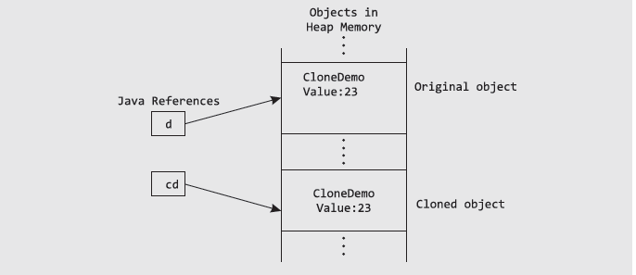
Shallow copy

Slide 66
Test the CloneDemo class
public static void main(String args[]) {
CloneDemo d=new CloneDemo(23);
System.out.println("Value in original object: "+d.getValue());
CloneDemo cd=(CloneDemo)d.clone();
System.out.println("Original object d: "+d);
System.out.println("Cloned object cd: "+cd);
System.out.println("Value in Cloned object: "+cd.getValue());
cd.increment();
System.out.println("Value after increment in Cloned object: "+cd.getValue());
System.out.println("Value in original object: "+d.getValue());}

Slide 67
class CloneReferenceTest {
int value;
CloneReferenceTest(int v) {
this.value=v; }}
class CloneDemo implements Cloneable {
// object reference created
CloneReferenceTest br;
CloneDemo() {
br = new CloneReferenceTest(12);
}
// clone method overridden
public Object clone() {
try {
return super.clone();
}
catch(CloneNotSupportedException e) {
System.out.println(e);
return null;
} } } // class declared for Testing Cloning

Slide 68
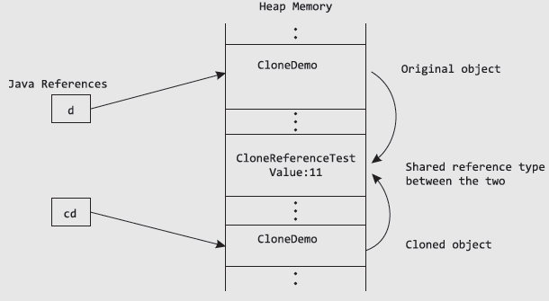
SHALLOW COPY OF REFERENCE TYPES

Slide 69
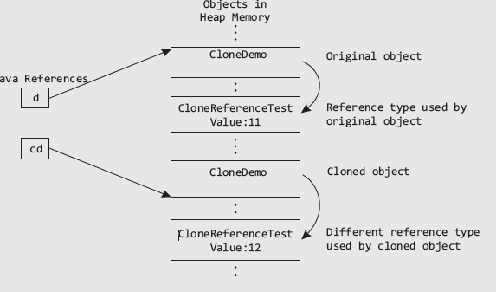
Deep Copying

Slide 70
Deep copying
class CloneReferenceTest implements Cloneable {
int value;
CloneReferenceTest(int v) {
value = v;
}
public Object clone(){
try {
return super.clone();
}
catch(CloneNotSupportedException e) {
System.out.println(e);
return null;
}}}

Slide 71
class CloneDeepDemo implements Cloneable
{
CloneReferenceTest br;
CloneDeepDemo()
{
br = new CloneReferenceTest(12);
}
public Object clone()
{
CloneDeepDemo cdd = null;
try {
cdd =(CloneDeepDemo) super.clone();
}
catch(CloneNotSupportedException e)
{
System.out.println(e); //return null;
}
cdd.br =(CloneReferenceTest)br.clone();
return cdd;
}
}
………………..

Slide 72
Summary
JDK 1.4 introduced java.nio package in addition to the java.io package.
The I/O in Java is based on streams: byte and character.
The classes in both categories have been discussed in this chapter to show how to read and write data (both byte and character) to files.
RandomAccessFile class is used for reading and writing a file randomly by setting the file pointer at a particular position in the specified file.
Java 6 introduced Console class for user input and output to the user.
We discussed about cloning: and its types – shallow and deep copying.
How shallow copying and Deep Copying is performed?

